Slide 1

Why to Choose Agile Methodology

Slide 2

Waterfall
“The classic approach to systems development life cycle”
(Cobb, page 4)

Slide 3

“a sequential development process that flows like a waterfall through all phases of a project”
Stages:
Requirements
Design
Implementation
Testing
Deployment
Key Points:
A linear approach to development.
Preset goals.
Plan driven.
Does not embrace change.
All quality testing is done upon completion of development.
(Adobe Corporation, 2021)

Slide 4
An “approach that emphasizes a linear progression from beginning to end of a project”.
Advantages:
Straightforward and well defined
Design errors are caught during analysis
Accurately estimated costs and timeline
Easy to measure progress
Easy to add new team members
Customers can’t add new requirements
Disadvantages:
Upfront project planning
Little room for flexibility
Change are time consuming and costly
Lack of client involvement
If there is a delay at one phase of the project, all phases are delayed
(Adobe Corporation, 2021)

Slide 5
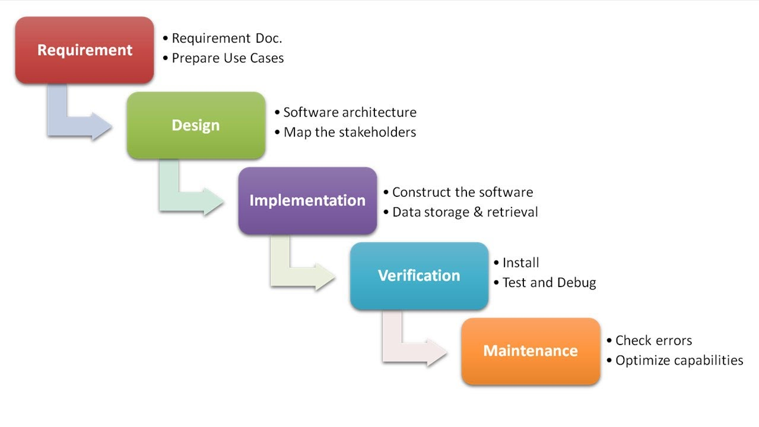
Waterfall SDLC
Photo credit: antossoftwaretopics https://kenscourses.com/tc1019fall2016/tag/waterfall-method/

Slide 6

Agile
“Responding to change over following a plan”
(Beck, et al., 2021)
Photo credit: BK Blog Post
www.bkconnection.com/bkblog/laura-goodrich/emotional-agility-how-to-make-your-workforce-emotionally-agile

Slide 7
“Real Time Decision-Making processes based on actual events and information” (cobb, page 5).
Principles:
Prioritize customer satisfaction
Welcome change
Delivery of working software frequently
The client, leadership, and development team all work together daily
Build the project around the individuals needs and trust your team to get the job done
Face-to-face communication
Progress is measured by working software
Sustainable development
Technical excellence
Simplicity
Self-organized teams
Frequent team reflection to enhance effectiveness
(Beck, et al,. 2021)

Slide 8
Agile helps teams “improve productivity while allowing them to boost creativity and create unique solutions” (Green, 2021).
Advantages:
Increased focus on the outcome
Reduced start up time
Working product is released incrementally
Focus of simplicity
Eliminate bottlenecks
Higher quality final product
All team members are respected and empowered
(Cobb, pages 11-12)
Disadvantages:
Uses trial and error which can slow the process down
The client can constantly request changes
Difficult to estimate costs
Flexibility and self-organization can lead to poor time managment

Slide 9
The Scrum Team
Product Owner
Scrum Master
Developers
Testers

Slide 10
Product owner:
The product owner collaborates with and represents the stakeholders ensuring that the scrum team understands their vision and brings it to life. They are responsible for creating the product backlog that the development team will base the project around and organizing it in the appropriate order it to achieve the teams goal. The Product owner shows the team the clients vision and guides them to make it a reality.

Slide 11
Scrum Master:
The Scrum master is responsible for making sure the team understands and “adheres to Scrum theory, practices, and rules” (Cobb, page 36). The Scrum master facilitates communication about achievements, goals, and obstacles then works to eliminate those obstacles. They help the product owner manage the backlog and they coach the development team and do everything in their power to make sure the team is successful.

Slide 12
The developers:
The developers are self-organized and use their creativity to bring the stakeholders vision to life. They create sprint increments and work to deliver products that are “done” at the end of each sprint. Each developer is “expected plan their activates and to be accountable for delivering the results that they committed to” (Cobb, page 39). They are the creators that make dreams reality.

Slide 13
The Testers:
The testers are responsible for creating test cases that encapsulate the desired end result for each user story. They are then expected to test the products delivered to them by the developers and only when those products meet the requirements can they be considered “done”. The testers ensure that only the highest quality of products are released to the customer and are the key to making sure the customer is satisfied.

Slide 14
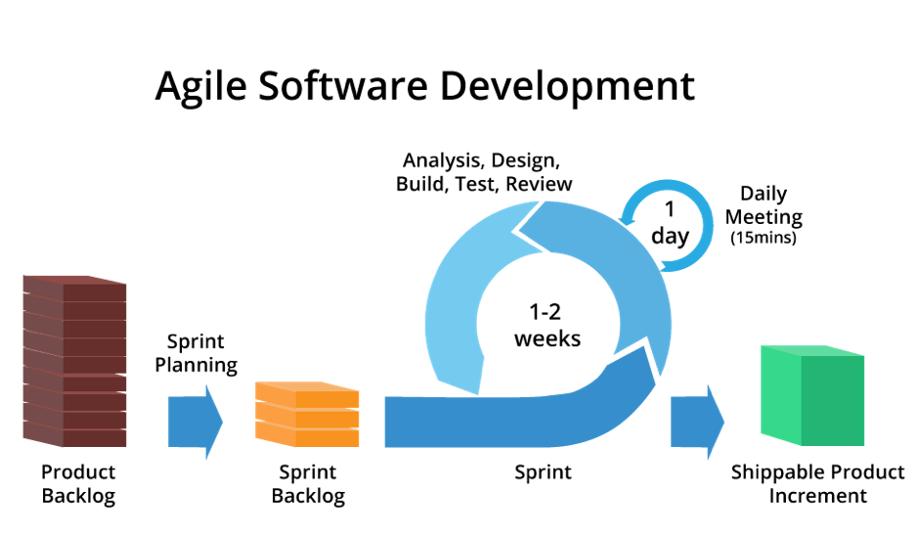
AGILE SDLC
Sprint planning: The development team decides how much of the product backlog to take into the upcoming sprint. It is important that they set a goal large enough to keep them occupied for the length of the sprint but not so large that they cannot complete their tasks on time.
Sprint: “The heart of the scrum process” (Cobb, 40). A set interval of time in which the development team completes increments of the project they committed to in the planning phase.
Photo credit: Testing Cycles testingcycles.com/agile-development-in-sdlc/

Slide 15
AGILE SDLC
Daily meetings: short “standup” meetings are held each day to discuss each team members accomplishments, goals, and what obstacles are standing in the way of their success.
Testing and Review: Test cases are used to make sure the product increments meet all of the requirements. When the product is considered “done” it is shippable. Sprint reviews are then held in which the team “presents their finished work to the product owner for final approval” (Cobb, page 42).
Photo credit: Testing Cycles testingcycles.com/agile-development-in-sdlc/

Slide 16

Applying Methodologies to SNHU Travel Project
Planning:
During the planning process the use of agile methodology allowed the project to begin before the client had a clear vision of exactly what they wanted. The use of waterfall would have required more upfront planning and the client would have been required to supply more details before development began.
Photo Credit: Vagabond Summer
https://vegabondsummer.com/travel-enjoy-world-offer/

Slide 17
Applying Methodologies to SNHU Travel Project
Change:
When the sprint was nearly complete the client changed the theme for their desired top-5 vacation packages. This was only a minor setback while using the agile approach. If the waterfall approach was being used making these changes would have been much more difficult and may have resulting in a need to completely restart the project from scratch.
Photo Credit: Vagabond Summer
https://vegabondsummer.com/travel-enjoy-world-offer/

Slide 18
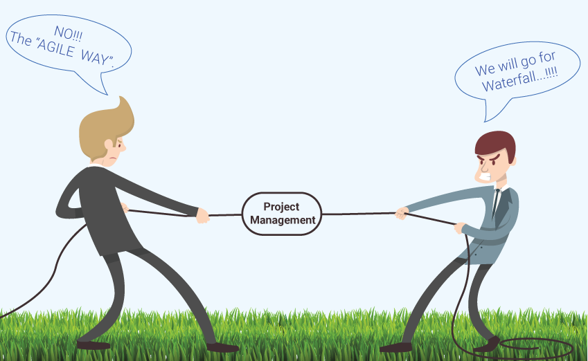
The choice is yours
When choosing between waterfall or agile approaches one should take into consideration how much pre-planning they prefer vs. their ability to go with the flow and how mature their team is. Can you trust your team to set appropriate goals without wasting too much time or do they still need more guidance? Does the project need to follow strick guidelines or can you allow your team a bit of creative freedom?
Photo Credit: Shenika Balfour
https://digitalmarketing.temple.edu/mis5102sum2018/2018/07/23/agile-vs-waterfall-which-is-the-right-methodology-for-my-company/

Slide 19
References:
Adobe Corporation (2021). Waterfall Methodology: What is the Waterfall methodology?
http://www. workfront.com/project-management/methodologies/waterfall#:~:text=%205%20common%20stages%
20in%20a%20Waterfall%20process,implementation%20starts.%20This%20might%20be%20the...%20More%20
Beck, K., Beedle, M., Van Bennekum, A., Cockburn, A., Cunningham, W., Fowler, M., Martin, R., Mellor, S., Thomas, D., Grenning, J., Highsmith, J., Hunt, A., Jeffries, R., Kern, J., Marick, B., Schwaber, K., Suherland, J., (2001-2019). The Agile Manifesto: The 12 Principles of Agile. Agile Alliance.
Cobb, C. (2015) The Project Manager’s Guide to Mastering Agile: Principles and Practices for an Adaptive Approach. Wiley.

